Slide 1
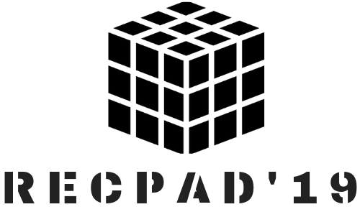
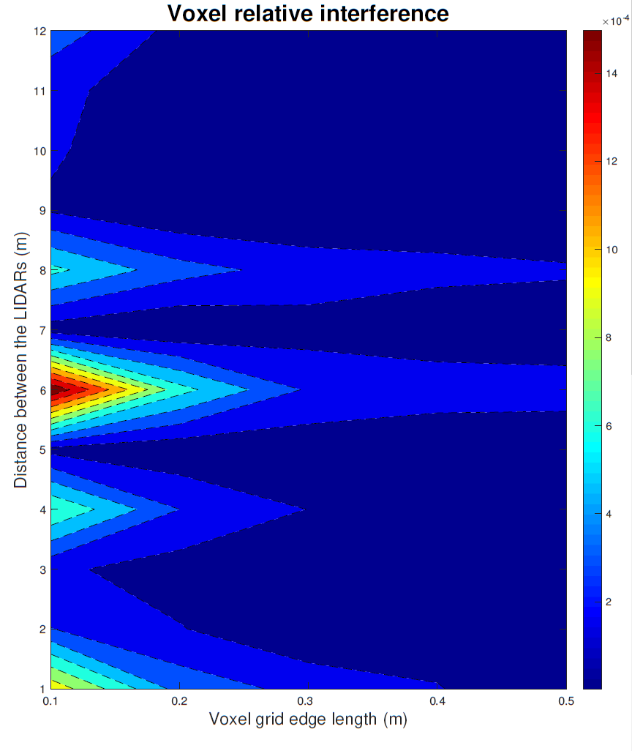
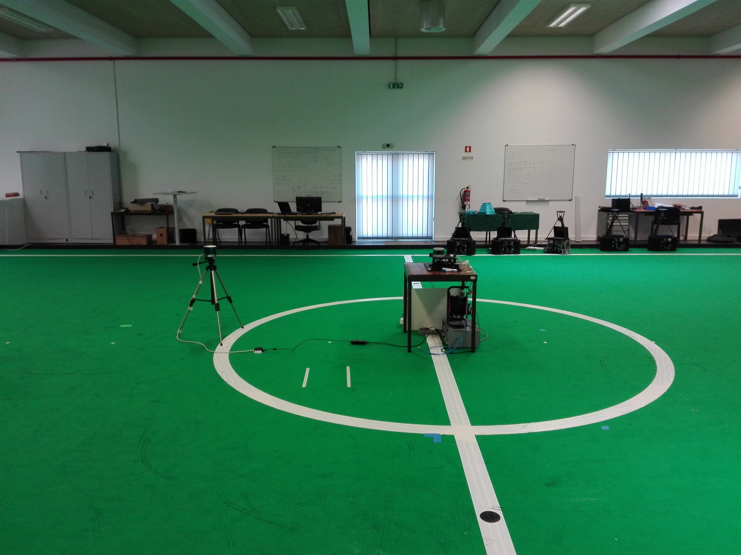



Impact of Interference on Time-of-Flight LiDAR
Pedro Martins (martinspedro@ua.pt), António Neves, Miguel Drummond, André Albuquerque
What you should take away from this poster
Increasing road deaths are pushing self-driving vehicles to become a reality, forcing the development of self-driving technology to accurately understanding their environment. LiDAR is as one the most promising sensors to, being deployed as the solution without any insights on how would they operate on an environment where multiple LiDARs coexist. Our research focused on understanding this behavior with the distance between the LiDARs and the length of the voxel grid edges used for the statistical analysis. We conclude that a smaller length of the voxel grid edges increases slightly the magnitude of the interference, for a fixed distance; and other factors appear to be more relevant than distance. In a “worst case scenario”, one in a thousand points is expected to be interfered when two LiDARs coexist, which might be enough to compromise the detection of small objects. Further research on the interference characteristics and its impact on self-driving algorithms must be carried.
Why it is a problem?
LiDAR (Light Detection And Ranging), sensors map their surroundings because of their capability of precisely measuring depth, with a few centimeters of error, over distances that can range until 100 meters or even 300 m in certain conditions. This sensor is being employed as the solution to help cars understand the world around them, but there is a caveat that has not being addressed or deeply considered by the scientific community: LiDARs interfere with their surrounding environment.
Why it happens?
Since LiDAR is an active sensor, it sends laser pulses (from a tenths to a few thousand of pulses per second) to the space surrounding them. Laser’s divergence and the detector’s FOV are small, but what happens when a hundred or thousands cars with LiDARs “flood” the streets? Do they interfere mutually, i.e., the laser emitted by a LiDAR on a car “A” interferes with the detector of the LiDAR of a car “B”? And if so, how do they interfere and what are the consequences?
Why it is important ?
In a society where automotive manufacturers are concerned about deploying autonomous driving technologies and cars to the streets as soon as possible, governments lack scientific expertise to legislate on the topic and experts hope that self-driving cars could help reduce the number of road deaths, this research work focuses on understanding what happens if multiple LiDARs interact with each other, to prevent road deaths caused by technology.
Fig 2- Contour graph of the results. On the horizontal axis the voxel edge length is varied between 0.1 and 0.5 m with steps of 0.1 m. On the vertical axis, the relative distance (keeping the LiDAR orientation with zero azimuthal angle) is varied meter by meter between 1 and 12 meters.
How did we try to understand it?
We devise an experimental setup with two LiDARs (Fig. 1):
The “victim”, fixed on the table, which was used to acquire data from the surrounding environment;
The “interferer”, mounted on a tripod.
For the “victim” a Velodyne VLp-16 was used and for the “interferer” a Hesai Pandar40 was chosen. Both LiDARs rotate at 600 Rotations Per Minute (RPM).
To capture, manage and analyze the datasets, software was developed in C++, using the Robotic Operative System (ROS) framework and the Point Cloud Library (PCL).
The data is gathered in two conditions: when the “interferer” is off and when the “interferer” is on. The test scenario described on this poster consists on measuring the two scenarios for distances between the LiDARs of 1 until 12 meters, with a step of one meter. No other parameter was changed and the LiDARs were facing each other with no obstacles in their line of sight.
How did we quantify the interfence?
With all the point clouds gathered when the “interferer” is off, a ground-truth model is computed using the Interative Closest Point algorithm and a Voxel Grid filter, to reduce the noise and keep an uniform point density.
The 3D space is divided in voxels (the equivalent of a pixel in 3 dimensions) and we mark which voxels are occupied, based on the point clouds. The interference is evaluated by comparing the voxels occupied on the ground-truth with the voxels occupied when interference is present (Fig. 2). The length of the voxel edge was also varied, to account for the severity of the errors on the depth measurement.
What did we find?
We conclude that:
The lower the voxel grid edge length, the higher the effects of the interference.
Increasing the distance between the LiDARs has no obvious correlation with the interference.
How do we relate with the similar works?
Previously available results have shown that on 2D LiDARs an error of 1 in 10000 points is expected. Our findings not only extended this study to 3D LiDARs, more common in self-driving vehicles, but also discovered that the severity of errors is highly volatile and can be one order of magnitude higher than previous findings.
Therefore further investigations are required to identify the main factors influencing mutual interference between LiDARs and also to quantify their severity in object detection and recognition, crucial to the safe deployment of self- driving cars.
Fig 3- Rigid body transform representation for all the referentials used on this work. base_link is the car referential, imu_link, velo_link and camera_color_left the imu, LIDAR and camera referentials, respectively.
You might also be interested on:
G. B. Popko, T. K. Gaylord, and C. R. Valenta, “Signal interactions between lidar scanners”, in Laser Radar Technol. Appl. XXIV, M. D. Turner and G. W. Kamerman, Eds., vol. 11005, SPIE, May 2019,
G. Kim, et al., "An Experiment of Mutual Interference between Automotive LIDAR Scanners, 2015, "International Conference on Information Technology - New Generations, Las Vegas, p. 680-685
Fig 1- Experimental setup on an interior Middle Size League robotic soccer field.

